Slide 1

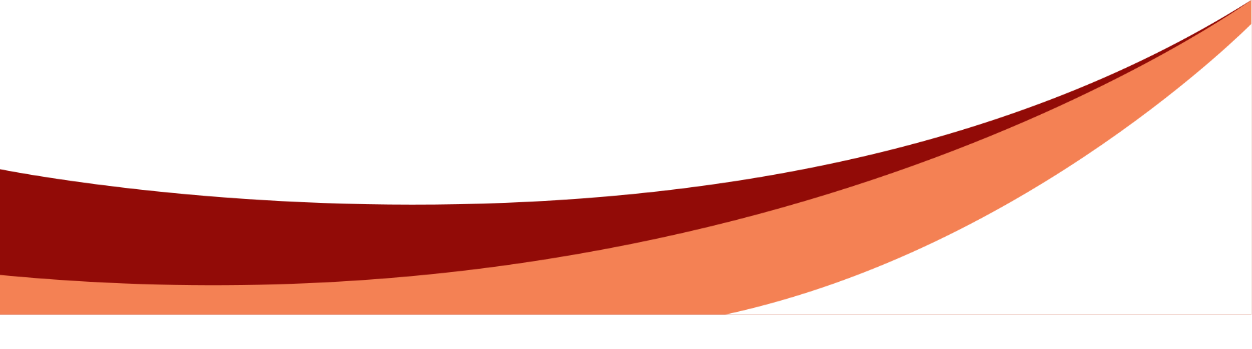
Capstone project - phase 1
Estimation of smoking associated damage based on nuclear lung images
By:
Hani Zahran
Tarek Sleiman
Supervisor: Dr. Zeev Frankel

Slide 2

Introduction
Our project aims to combine artificial intelligence with medical diagnostics to create software that detects lung diseases caused by smoking through medical imagery analysis. This innovative application seeks to enhance the accuracy and efficiency of diagnosing smoking-related illnesses.

Slide 3
Problem
1
2
3
Inaccurate Diagnoses
Variable Interpretation
Impact on Treatment
Many lung diseases are diagnosed late or incorrectly due to the limitations of traditional diagnostic methods.
X-rays require expert interpretation, which can be subjective and inconsistent.
Delayed or incorrect diagnoses can lead to ineffective treatment plans and higher mortality rates.

Slide 4

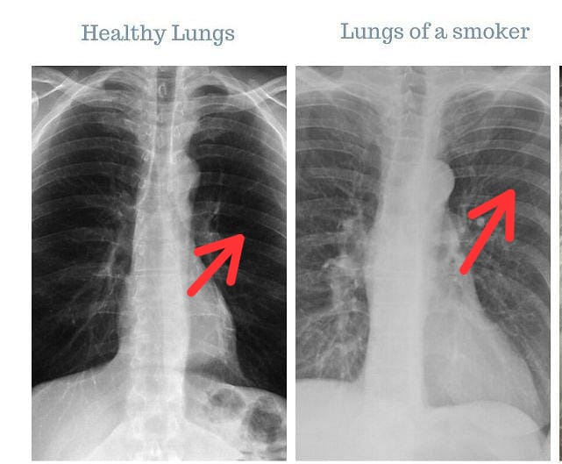
Examples of x-ray image

Slide 5
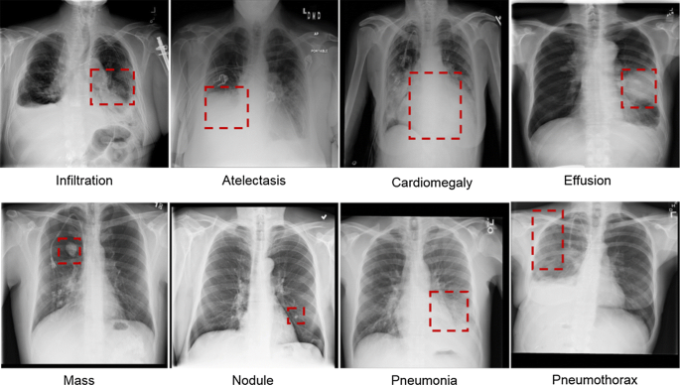
1
3

Slide 6





Current State
Doctors still depending on themselves (reading the X-ray).
There are some applications that analysis the X-ray but they are not accurated

Slide 7
Our Solution
Advanced Imaging Analysis: Utilize advanced imaging analysis techniques to improve the accuracy of lung disease diagnosis.
Automation and AI: Implement automated systems and AI algorithms to assist in the interpretation of lung X-rays.
Enhanced Accuracy: Provide more consistent and reliable diagnoses, reducing the variability and subjectivity of human interpretation.

Slide 8

Algorithm Overview
Data Preprocessing:
Load the lung images.
Normalize the images to a standard scale.
Augment the dataset to improve model robustness (e.g., rotations, translations).

Slide 9
2. Model Construction:
Define a CNN architecture with convolutional, activation, pooling, and fully connected layers.
Configure the training process (loss function, optimizer).

Slide 10
3. Model Training:
Train the model using the preprocessed images.
Validate the model using a separate validation set to monitor performance and avoid overfitting.

Slide 11
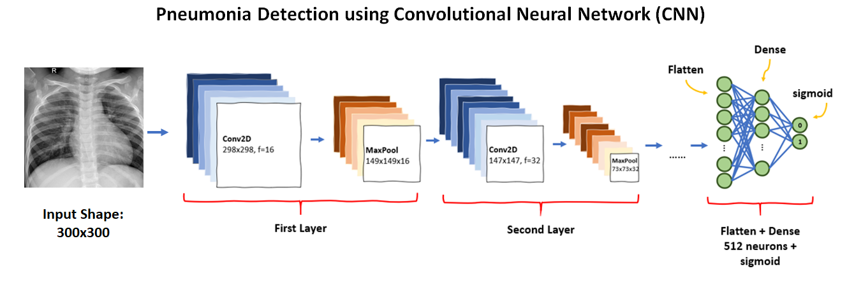
How Our Algorithm Work

Slide 12
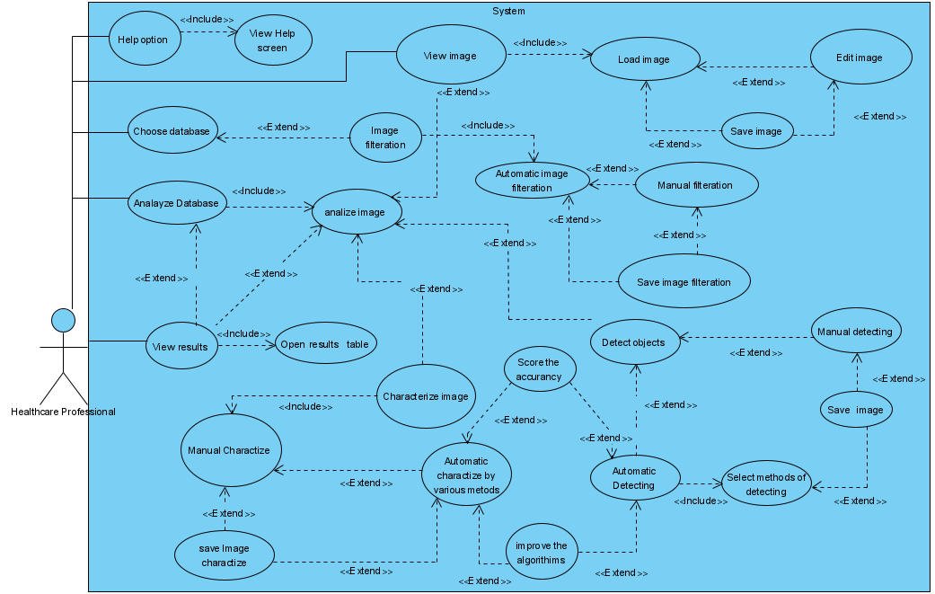
Use Case

Slide 13
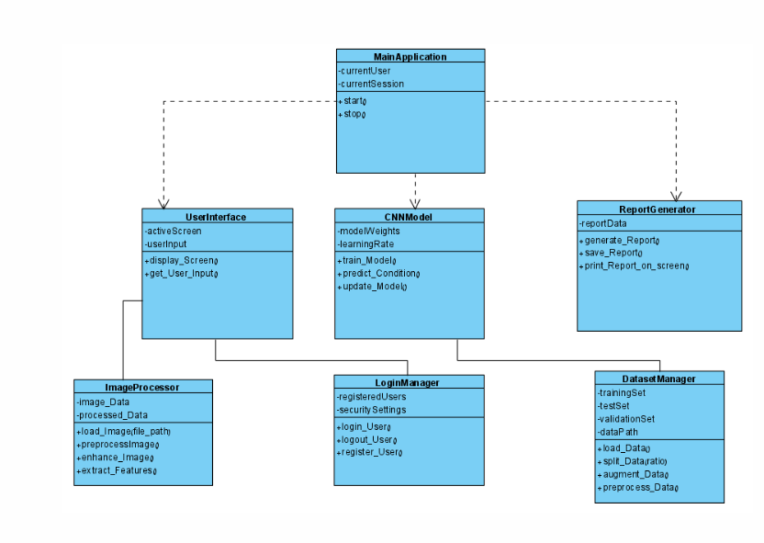
Class diagram

Slide 14
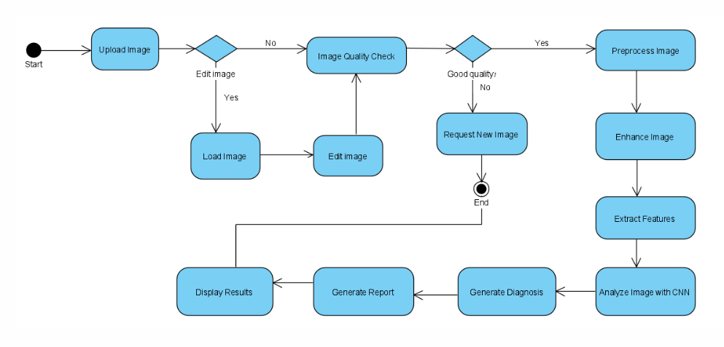
Activity diagram

Slide 15
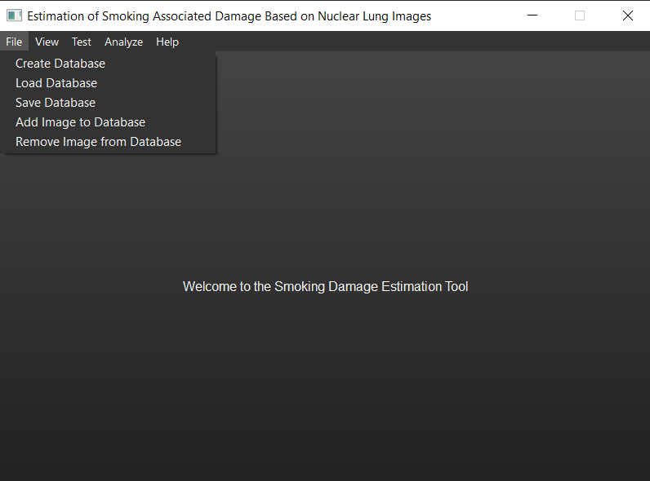
GUI

Slide 16
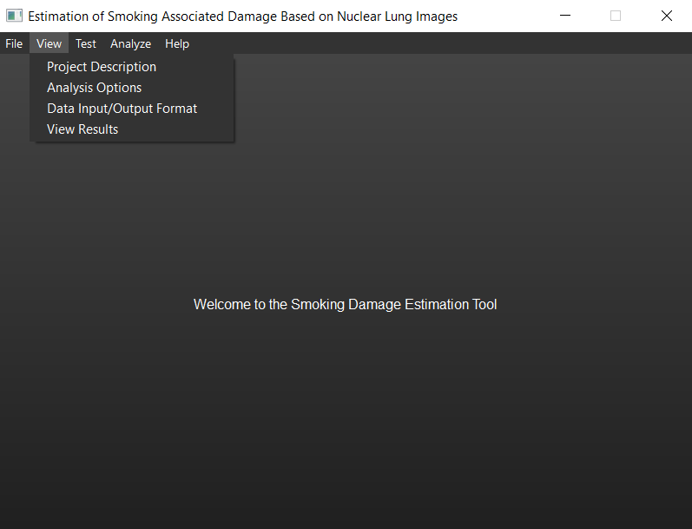
GUI

Slide 17
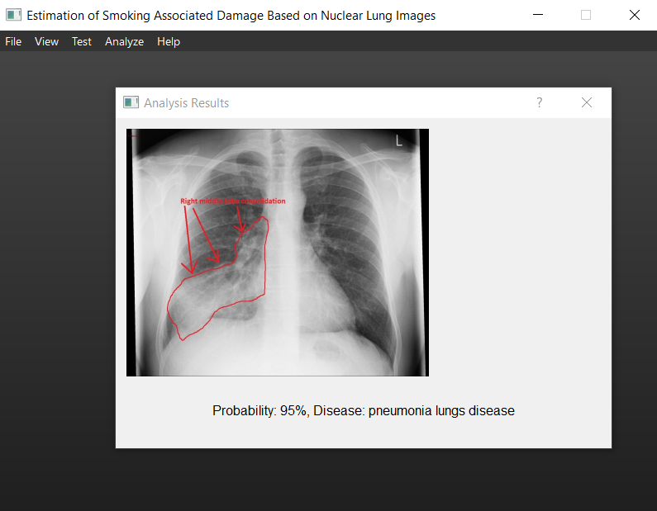
GUI

Slide 18
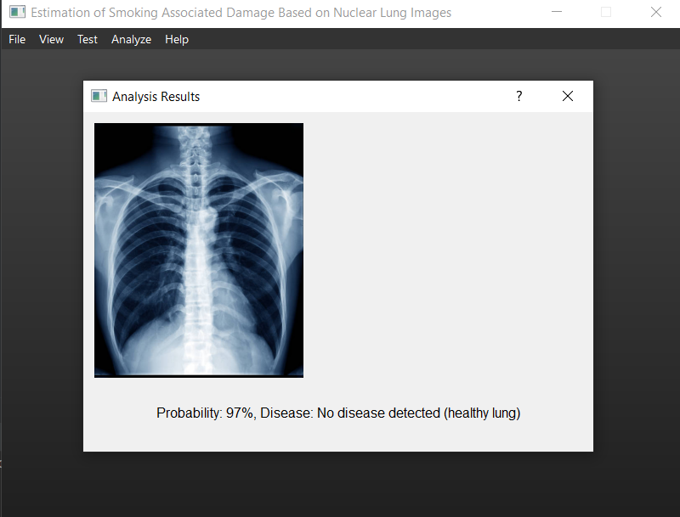
GUI

Slide 19

Testing Plan
Objective: Firstly we have to ensure that our application analyzes lung images, identifies anomalies, and differentiates between smokers and non-smokers with high precision and reliability.

Slide 20
Testing Plan
Unit Testing: Individual components of the AI algorithms will be tested for functionality and performance.
Integration Testing: Test how integrated components (e.g., image preprocessing and AI analysis modules) function together.
System Testing: Evaluate the complete system’s performance under various conditions.

Slide 21
Thank you
For Listening

